Slide 1

Audiovisual Media Management in Libraries
Course Code: LIS 421
Lecturer: DR. I. E. OBIM

Slide 2

Introduction
Audiovisual Resources
Library Management
User Experience
Audiovisual (AV) resources include materials such as films, sound recordings, videos, slides, CDs, DVDs, and digital streaming content.
Libraries must manage these resources effectively to ensure accessibility, preservation, and integration into the broader information system.
Proper organization enhances user experience and supports teaching, research, and cultural preservation.

Slide 3

Topic: Organization of Audiovisual Resources
Cataloging Audiovisual Materials
Cataloging Standards
Definition
AACR2 / RDA (Resource Description and Access): Provide rules for describing AV formats.
MARC (Machine-Readable Cataloging): Used to encode bibliographic data for AV resources.
Cataloging is the process of creating bibliographic records that describe and identify library materials.
Challenges with AV materials
Unlike books, AV resources often lack standardized title pages or consistent metadata.
Example
A DVD of a documentary may require cataloging of title, director, producer, year of release, format, and duration.

Slide 4
Metadata and Classification for Audiovisual Resources
Metadata
Importance
Structured information describing AV materials (e.g., creator, subject, format, language, duration).
Metadata supports discovery, retrieval, and interoperability across systems.
Classification Systems
Example
Dewey Decimal Classification (DDC) and Library of Congress Classification (LCC) can be adapted for AV materials.
Subject headings (e.g., Library of Congress Subject Headings) provide thematic access.
A music CD might be classified under "780 – Music" in DDC, with metadata including artist, genre, and track list.

Slide 5

Developing a Classification System for Audiovisual Materials
Need for Customization
AV materials often require specialized classification beyond traditional book systems.
Steps in Developing a System
01
02
Identify types of AV resources (films, sound recordings, digital files).
Define categories based on format, subject, and intended use.
03
04
Establish codes or call numbers for shelving and retrieval.
Ensure compatibility with existing cataloging standards.
Example: A library may create a local classification scheme where films are grouped by genre (Drama, Documentary, Educational) and assigned unique codes.

Slide 6

Integration of Audiovisual Resources into the Library's Existing Cataloging System
Unified Access
AV materials should be searchable alongside books, journals, and digital resources.
Integrated Library Systems (ILS)
Modern systems allow cataloging of diverse formats in one database.
Benefits
Users can discover AV resources through the same catalog interface.
Streamlined management for librarians.
Enhanced visibility of AV collections.
Example
A university library integrates streaming video databases into its OPAC (Online Public Access Catalog), allowing students to search for both books and films in one system.

Slide 7

Practical Considerations
Preservation
User Training
Technology Integration
AV materials are prone to deterioration (magnetic tapes, CDs). Proper storage and digitization are essential.
Libraries should educate users on how to access and use AV resources.
Use of digital repositories, streaming platforms, and multimedia databases.

Slide 8
Conclusion
Effective organization of audiovisual resources ensures that libraries remain relevant in the digital age. Cataloging, metadata creation, classification, and integration into existing systems are critical steps in making AV materials accessible, discoverable, and useful for academic and cultural purposes.

Slide 9
Discussion and Questions
Question 1
Question 2
Question 3
What challenges do libraries face in cataloging audiovisual materials compared to books?
How can metadata improve the discoverability of audiovisual resources?
Should libraries develop their own classification systems for AV materials, or rely on existing ones like DDC and LCC?

Slide 10
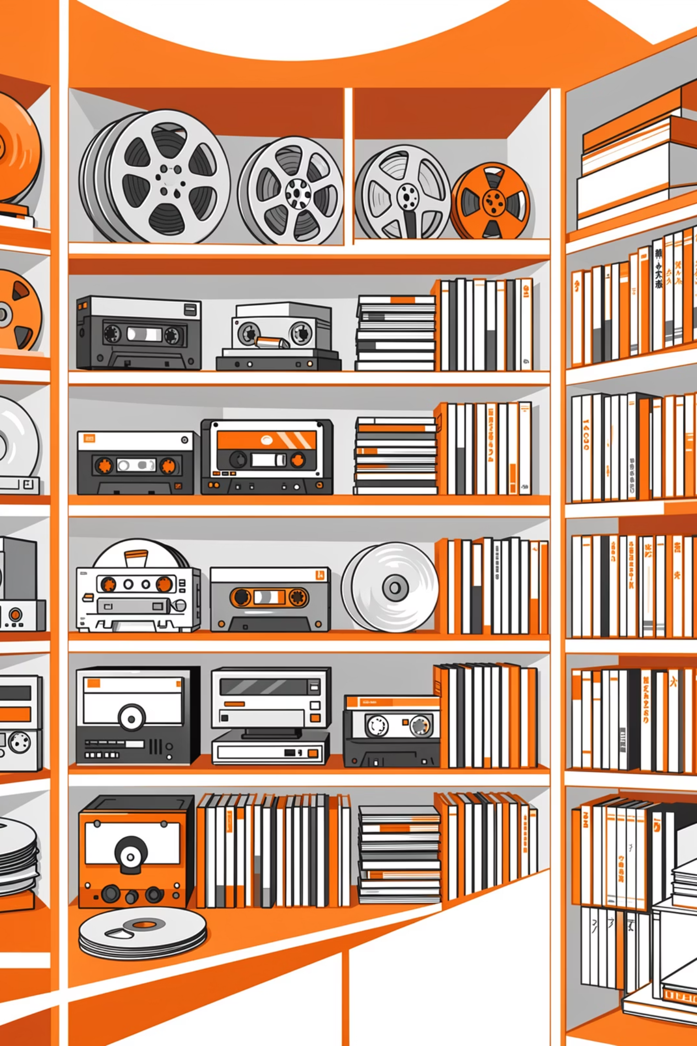

Topic: Preservation and Handling of Audiovisual Materials
Introduction
Audiovisual (AV) materials—such as films, videotapes, audiotapes, CDs, DVDs, photographs, and digital recordings—are vital information resources in libraries, archives, museums, media houses, and research institutions. Unlike printed books, audiovisual materials are highly vulnerable to damage because they depend on fragile physical carriers and rapidly changing technologies. Proper preservation and handling ensure that these materials remain accessible for teaching, research, cultural memory, and entertainment.

Slide 11
1. Challenges in the Preservation of Audiovisual Media
Preserving audiovisual materials presents unique challenges that are more complex than those associated with print resources. These challenges can be grouped into two major categories: physical degradation and technological obsolescence.
1.1 Physical Degradation
Audiovisual materials are made from magnetic tape, film stock, optical discs, or digital storage media, all of which deteriorate over time.
a. Magnetic Tape Deterioration
Audio and video tapes (e.g., VHS, cassette tapes) suffer from:
Binder hydrolysis (sticky-shed syndrome) -Mold growth
Demagnetization -Signal loss
Exposure to heat, humidity, dust, and magnetic fields accelerates this deterioration.
b. Film Decay
Motion picture films, especially acetate-based films, are prone to:
Vinegar syndrome (chemical breakdown producing acetic acid smell) - Fading of colors
Brittleness - Shrinkage and warping
c. Optical Disc Damage
CDs and DVDs may experience:
Scratches
Delamination
"Disc rot" (oxidation of reflective layer)
d. Mechanical Damage
Improper handling can lead to:
Fingerprints and smudges - Tangled tapes
Cracked discs - Broken cassette shells
Physical degradation is often irreversible, making preventive preservation essential.

Slide 12
1.2 Technological Obsolescence
Technological obsolescence occurs when playback equipment becomes unavailable or outdated.
For example:
Betamax players are now rare.
VHS machines are no longer widely manufactured.
Floppy disk drives are largely obsolete.
Even if the media is physically intact, it becomes useless without functioning playback equipment. Rapid changes in digital formats and software also create challenges for born-digital audiovisual files.
Obsolescence is one of the greatest threats to audiovisual heritage worldwide.

Slide 13
2. Methods for Storing and Handling Audiovisual Materials
Proper storage and careful handling significantly extend the lifespan of audiovisual collections.
2.1 General Handling Guidelines
Students, librarians, and archivists should observe the following:
Wash and dry hands before handling materials.
Avoid touching the surface of tapes, discs, or film.
Hold discs by the edges and center hole.
Rewind tapes after use before storage.
Use appropriate cases and containers.
Keep food and drinks away from AV materials.
Good handling reduces mechanical damage and contamination.

Slide 14
2.2 Storage Methods
Proper storage depends on the format:
a. Magnetic Tapes
Store vertically like books.
Keep in original cases.
Avoid stacking horizontally.
Rewind fully before shelving.
b. Film Materials
Store in ventilated archival film cans.
Avoid tightly sealed containers that trap acidic gases.
Separate deteriorating films from stable collections.
c. Optical Discs
Store in jewel cases.
Avoid paper sleeves for long-term storage.
Keep away from direct sunlight.
d. Digital Storage Devices
Use protective cases for external drives.
Maintain backup copies.
Avoid physical shocks and extreme temperatures.
Proper labeling and cataloguing are also essential for easy retrieval and reduced handling.

Slide 15
3. Environmental Controls for Audiovisual Collections
Environmental conditions play a critical role in audiovisual preservation.
3.1 Temperature
High temperatures accelerate chemical reactions that cause decay.
Recommended storage temperatures:
Magnetic tapes
Film materials
Optical discs
18–21°C
10–15°C (or colder for long-term preservation)
Below 23°C
Lower temperatures generally extend lifespan.

Slide 16
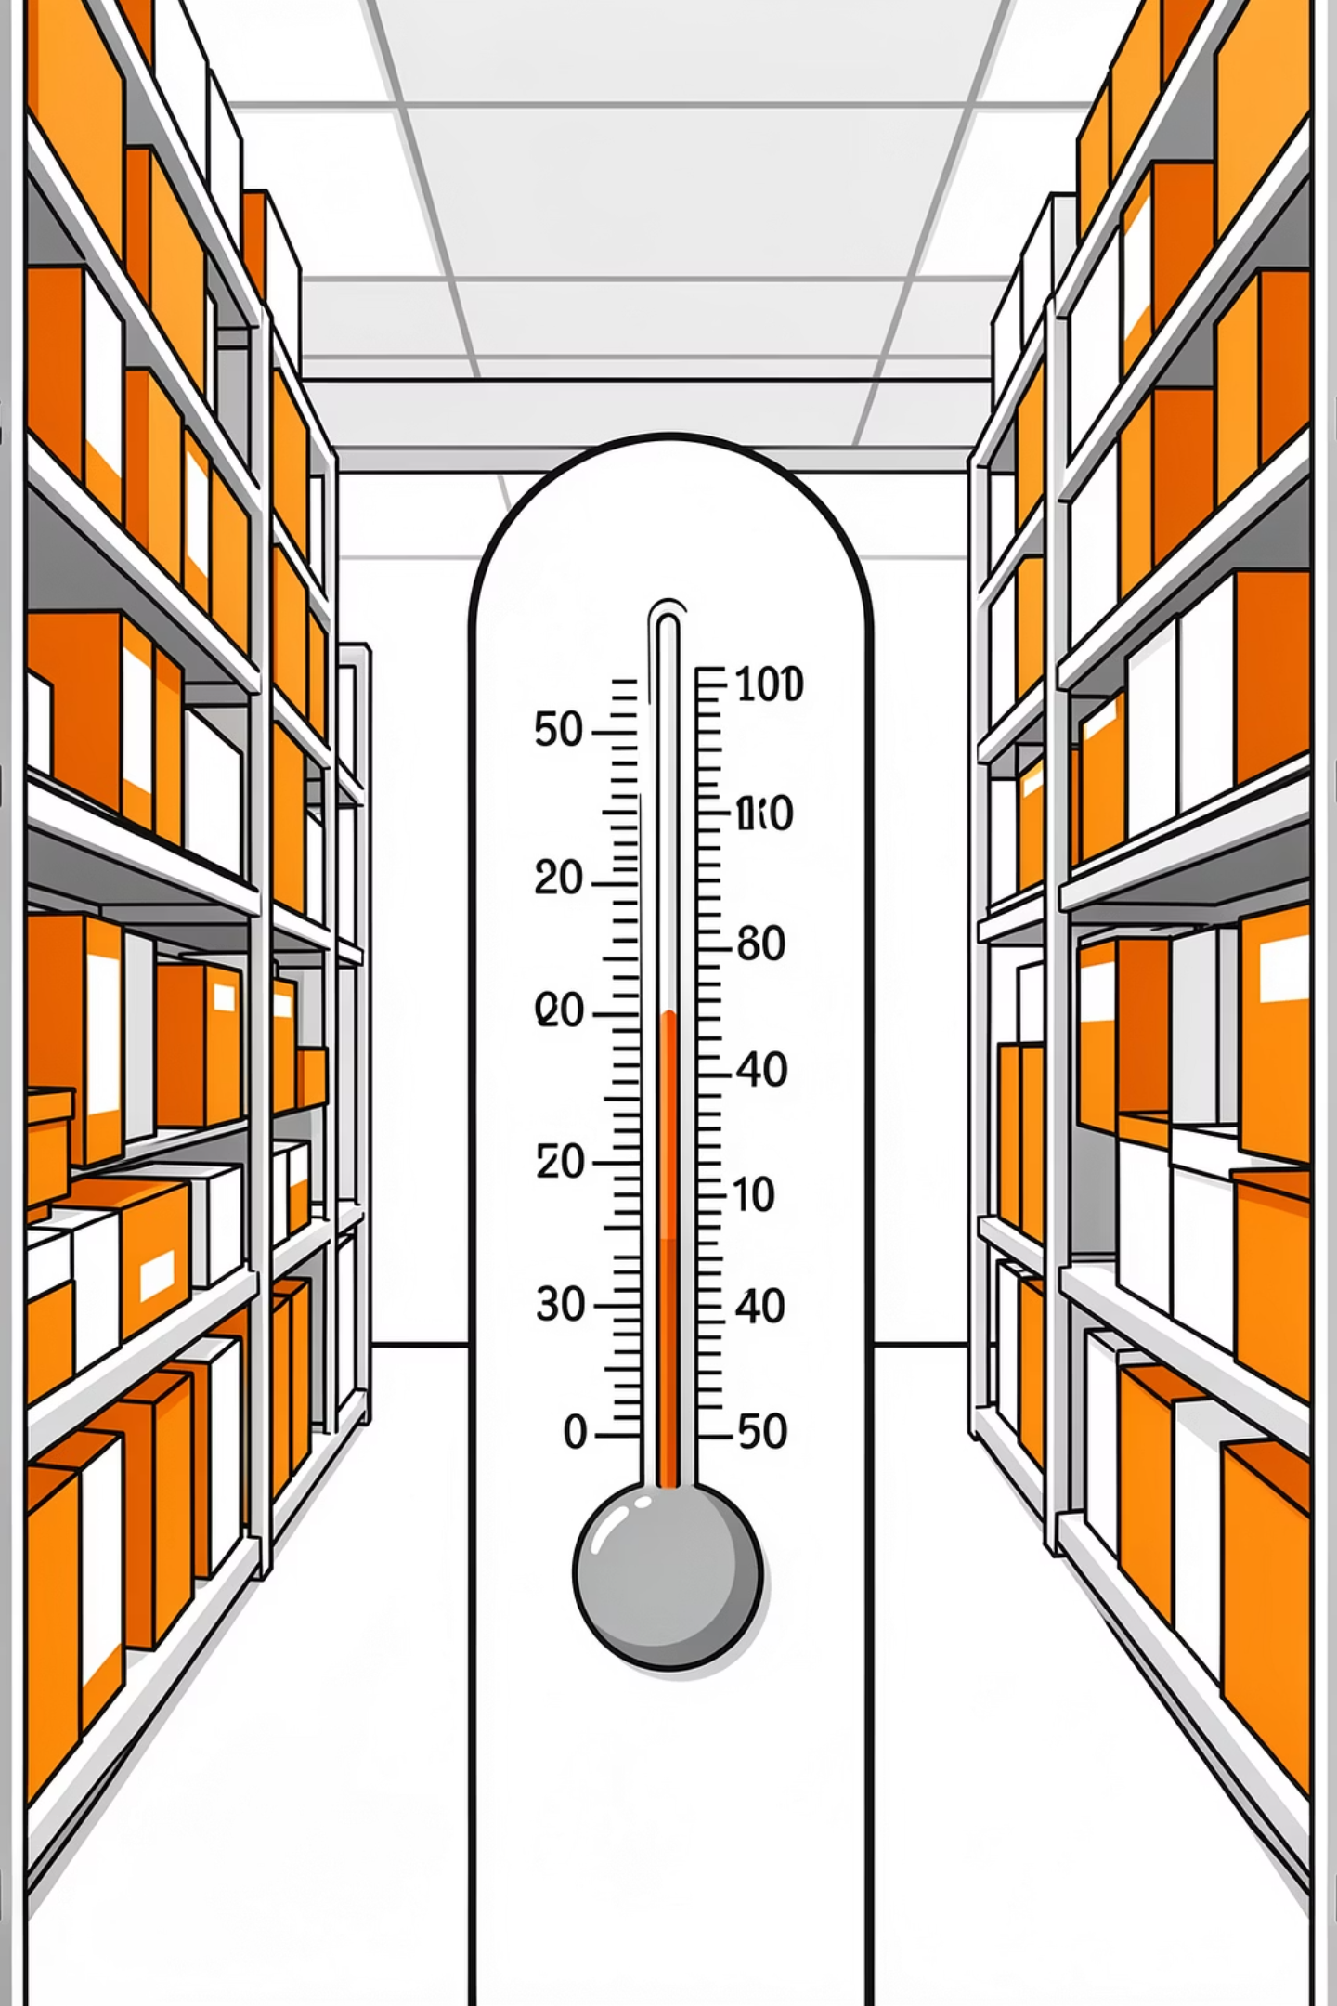
3.2 Relative Humidity (RH)
Excess humidity promotes mold growth and chemical deterioration, while very low humidity causes brittleness.
Recommended relative humidity:
30–50% RH for most AV materials
Stable conditions are more important than fluctuating ones.

Slide 17
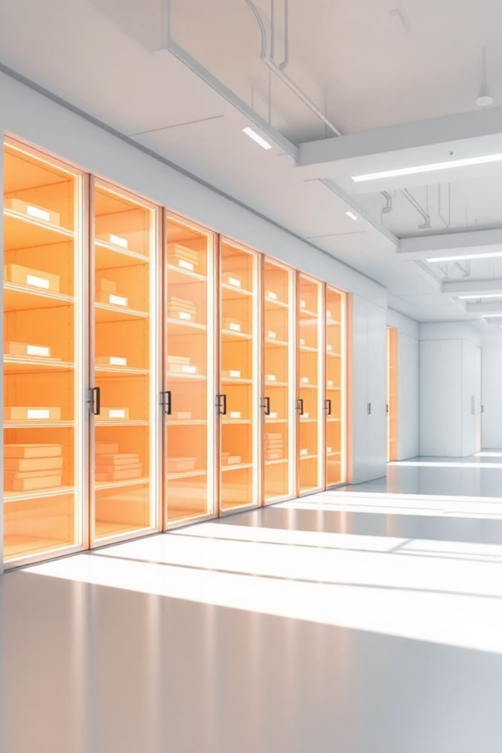
3.3 Light Exposure
Ultraviolet (UV) light damages film and photographic materials.
Store materials in dark areas.
Use UV filters in storage rooms.

Slide 18
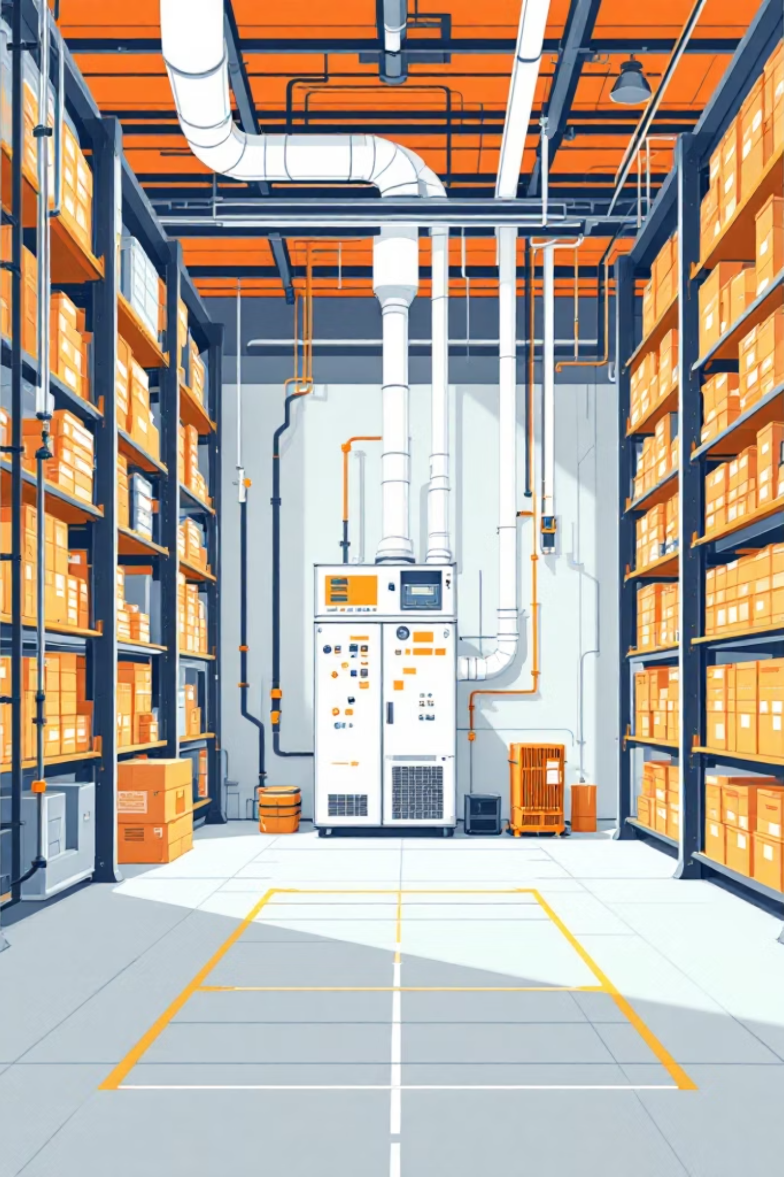
3.4 Air Quality
Dust, pollutants, and acidic vapors accelerate deterioration.
Ensure proper ventilation.
Use air filtration systems where possible.
Regularly clean storage areas.
Environmental monitoring tools such as thermometers and hygrometers should be used to maintain stable conditions.

Slide 19
Key Takeaways
Audiovisual materials are highly vulnerable
Two major challenges
Proper handling is essential
Physical degradation and technological obsolescence require different preservation strategies.
Unlike printed books, audiovisual materials depend on fragile physical carriers and rapidly changing technologies.
Good handling practices reduce mechanical damage and contamination, extending material lifespan.
Environmental control matters
Obsolescence is a critical threat
Temperature, humidity, light, and air quality must be carefully monitored and maintained.
Without functioning playback equipment, even physically intact media becomes useless.

Slide 20
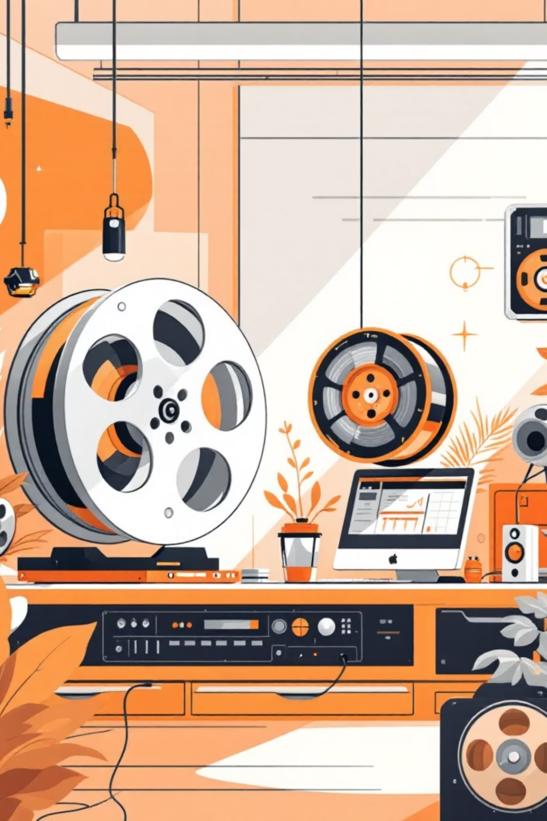
Topic: Digitization of Audiovisual Resources for Preservation and Accessibility
Digitization is one of the most effective strategies for preserving audiovisual materials and improving access.
What is Digitization?
Digitization is the process of converting analog audiovisual materials (e.g., tapes, film, vinyl records) into digital formats that can be stored, accessed, and shared electronically.

Slide 21
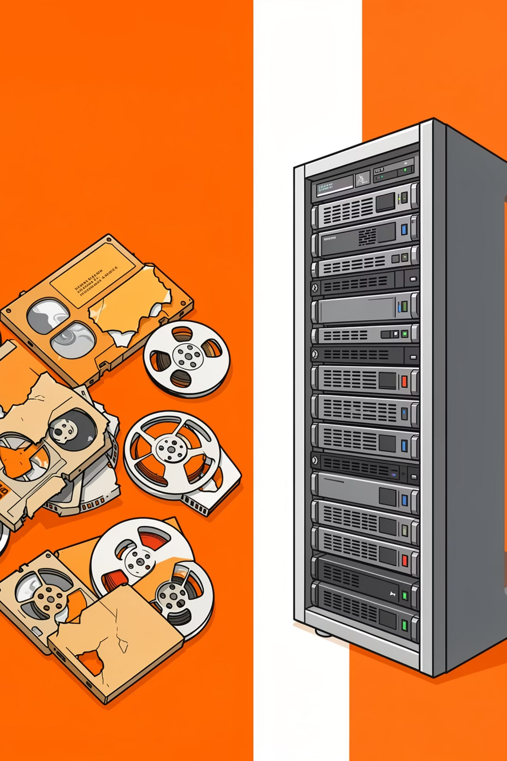

4.2 Importance of Digitization
Reduces handling of fragile originals
Prevents total loss due to degradation
Enhances accessibility via online platforms
Supports research and remote learning
Enables format migration
Ensures materials remain usable as technology evolves
Digitization is especially important in developing countries where older formats are rapidly disappearing.

Slide 22
4.3 Steps in the Digitization Process
Selection and Assessment
1
Identify materials at risk.
Prioritize rare and deteriorating items.
Preparation
2
Clean and repair materials.
Inspect for mold or damage.
Playback and Conversion
3
Use appropriate equipment.
Convert to high-quality digital formats (e.g., WAV for audio, MP4 for video).
Quality Control
4
Check for errors or signal loss.
Ensure accurate metadata.
Storage and Backup
5
Maintain multiple digital copies.
Store in secure servers or cloud systems.
Use external drives as backup.

Slide 23
4.4 Challenges of Digitization
💰 High Cost
👩‍💻 Skilled Personnel
🗄️ Storage Requirements
High cost of equipment and software
Need for skilled personnel
Large storage requirements
⚠️ File Corruption
🔄 Format Migration
Risk of digital file corruption
Continuous need for format migration
Digitization is not a one-time solution; digital files also require ongoing management and preservation planning.

Slide 24
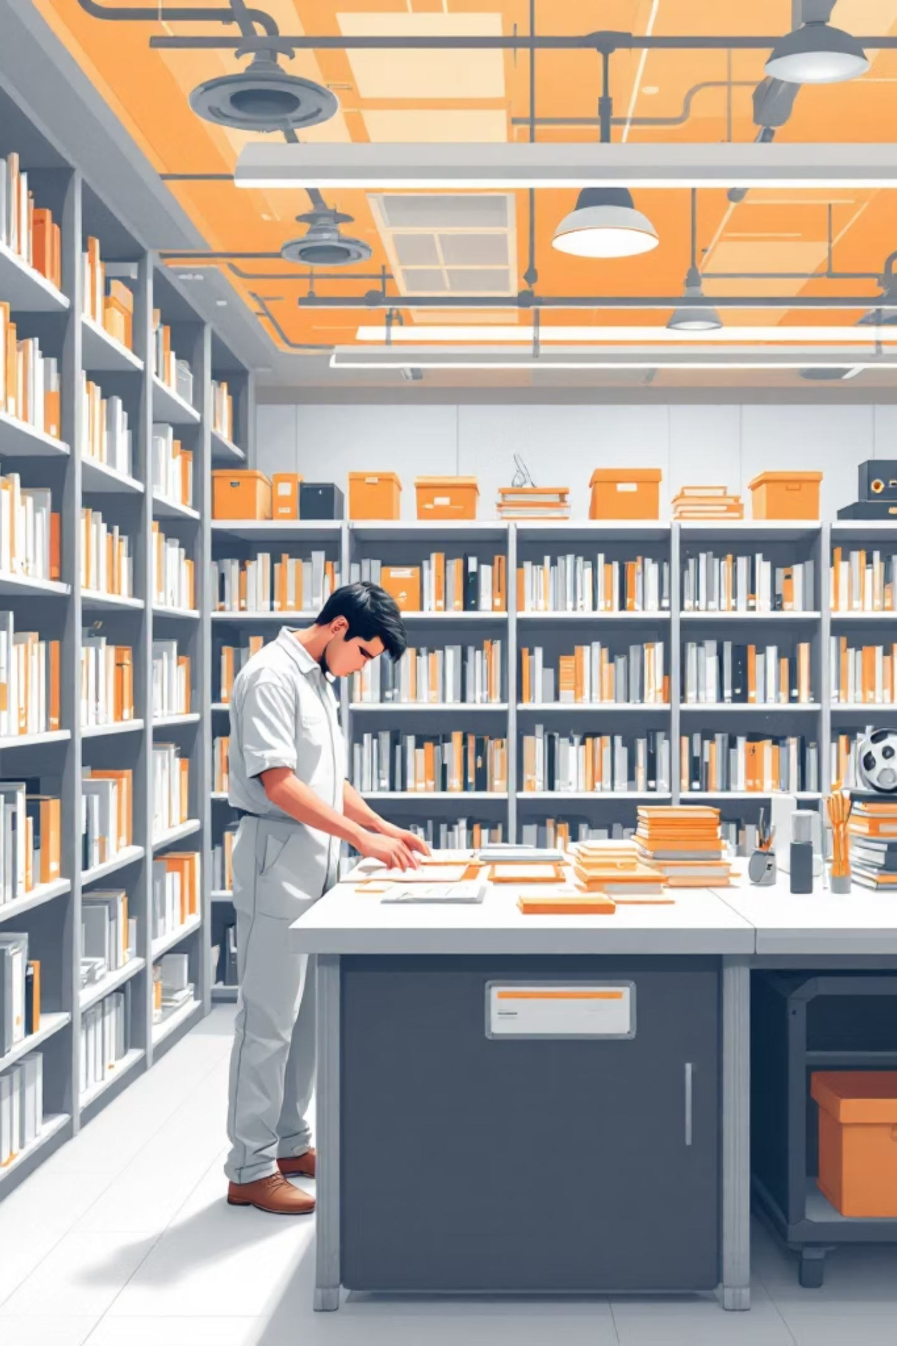



Conclusion
Preservation and handling of audiovisual materials require a combination of preventive care, environmental control, proper storage practices, and digitization strategies. Audiovisual resources are highly vulnerable to physical decay and technological obsolescence, making proactive preservation essential.
Correct Handling Techniques
Stable Environmental Conditions
Embracing Digitization
By implementing these strategies, libraries and archives can ensure long-term access to valuable audiovisual heritage for future generations.

Slide 25
Discussion Questions
1
Why is technological obsolescence a greater threat than physical decay in some cases?
2
What environmental factor poses the greatest risk to audiovisual materials?
3
How can Nigerian libraries improve audiovisual preservation despite limited funding?
4
Is digitization a permanent preservation solution? Why or why not?

